Slide 1

Physics Project
Mrs. Romano's Physics I Class
Spring Semester 2009
By: Dan Bechard

Slide 2
Introduction
My Physics I final project consists of two parts: A simple game and a moderately complex sandbox-style physics simulation. Both were programmed entirely by me using the C++ proramming language, SDL, OpenGL, and Code::Blocks IDE. Brief summaries of these tools will follow.

Slide 3
Tools
C++ was developed in the early 1980's as a general purpose computer programming language. It is still one of the most widely used languages today.
The Simple Direct Media (SDL) API is a library for C++ to assist with handling the application window, sound, and input.
OpenGL is a very well-known standard in the industry for the handling of 3D hardware accelerated graphics.
Code::Blocks is my C++ Integrated Development Environment (IDE) of choice.

Slide 4
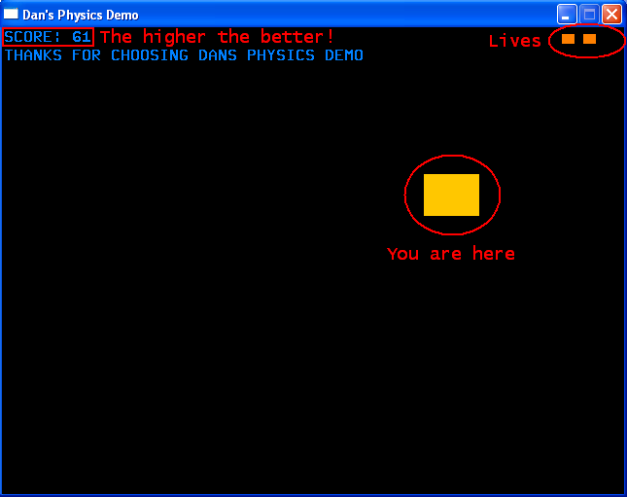
The Helicopter Game

Slide 5
Summary
The main purpose of this simple game is to demonstrate how all of the different physics concepts act alongside each other via an interface that is hopefully fun as well.
The player will directly control the force(s) being applied to the object, with the exception of gravity of course.
You have 3 lives. When you collide with any side you lose a life, your position is reset, and your velocity is set to zero again. The goal is to obtain the highest score before losing 3 lives.

Slide 6
Controls
The Q, W, & E keys will apply a force of 120.0N to the northwest, north, & northeast respectively.
Note: Keep in mind that everything is happening in exactly 2 dimensions, so applying a 120.0N force NW is the same as applying a 60.0N force north and a 60.0N force west at the same time.
Esc key exits. Due to implementation complexity/laziness there is no “reset” feature, so when you lose you must reopen the application.
Simple Fix: Don't Lose.

Slide 7
Score Is Velocity Based
Simply put: the faster you move, the faster your score goes up. For those of you who are a bit more curious as to how this works, the simplified logic is as follows:
multiplier = 0.05
If x velocity or y velocity is 0, multiplier = 0.01
(Moving along only one axis hinders your scoring abilities)
score += (xVel + yVel) * multiplier;

Slide 8
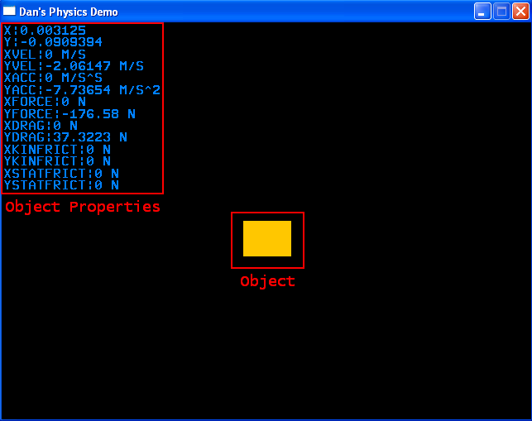
The Simulation

Slide 9
Object Properties
Perhaps the most important part of this whole simulation is the text in the upper left-hand corner of the window displaying the object's properties. Sure it may seem simple enough but let me tell you, creating your own bitmap font pixel-by-pixel is no joke. More on this later.
The properties being displayed are: Position, Velocity, Acceleration, Applied Force, Drag, Static Friction, & Kinetic Friction

Slide 10
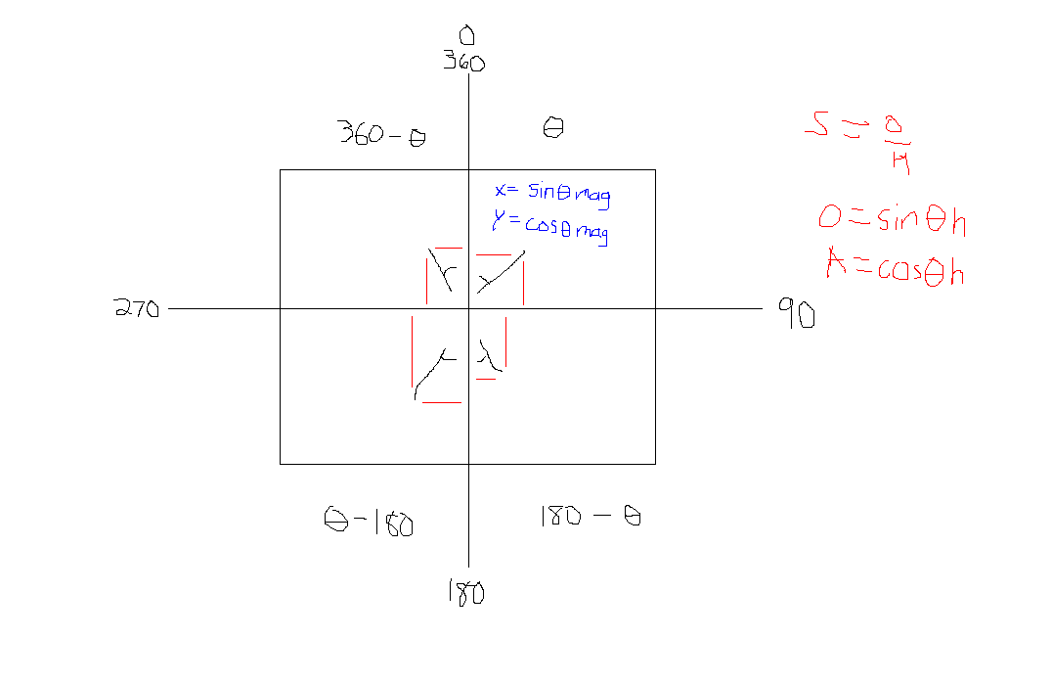
Angle System Diagram
(for vector direction)

Slide 11
Turning Forces Into Screen Coordinates
I've designed my object class (ignore the programming terms and bear with me if you will) so that adding forces is as easy as possible. Using the angle system shown in the diagram on the previous slide, applying new forces is easy.
Example: testObj->AddForce( 110.0, 270, 100 );
This function call would apply a force of 110.0N at an angle of 270 degrees (left) for 100 milliseconds.

Slide 12
Drag (Air Resistance)
1/2 * AirDensity * Velocity^2 * Area * DragCoefficient
Calculating the force of drag was the second most difficult thing I had to do for this project (don't forget the font). I must have looked at this equation at least 3 times (each time promising myself I wouldn't do it again) before finally deciding to attempt to implement it.
xDrag = (0.5 * 1.2 * (xVel*xVel) * 20 * 1.05);
Note: I used the average density of air at average temperature at sea level.

Slide 13
Static & Kinetic Friction
Note: Friction is only calculated when colliding with a surface (the floor).
I took great care when adding friction into the mix, because I had to make sure it was ALWAYS opposing the direction of the net force on the object. As a matter of fact my first attempt at friction resulted in the object accelerating to infinity (infinity being the point where the collision detection failed, the object flew off the screen, and the program crashed) rather than slowing down.

Slide 14
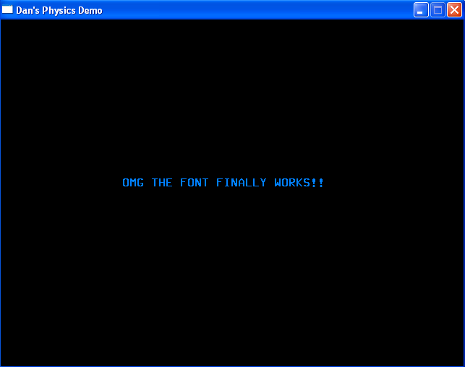
The Font
So I'll bet you're wondering by now why I can't stop complaining about creating the bitmap font.. let me sum up the process.

Slide 15
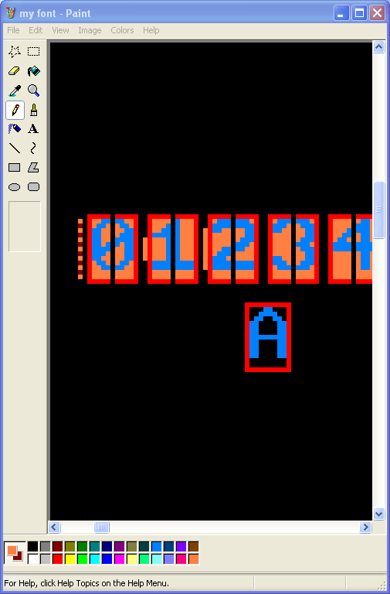
Step 1 – Draw It
Thankfully I found a ready-to-use bitmap font for the letters, but I still had to create the numbers and other misc. characters myself.

Slide 16
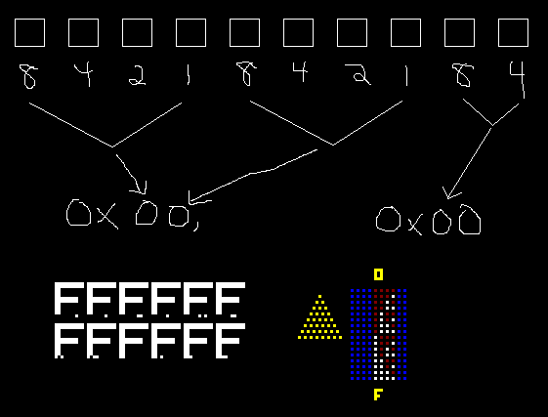
Step 2 – Figure Out What The Heck Is Going On

Slide 17
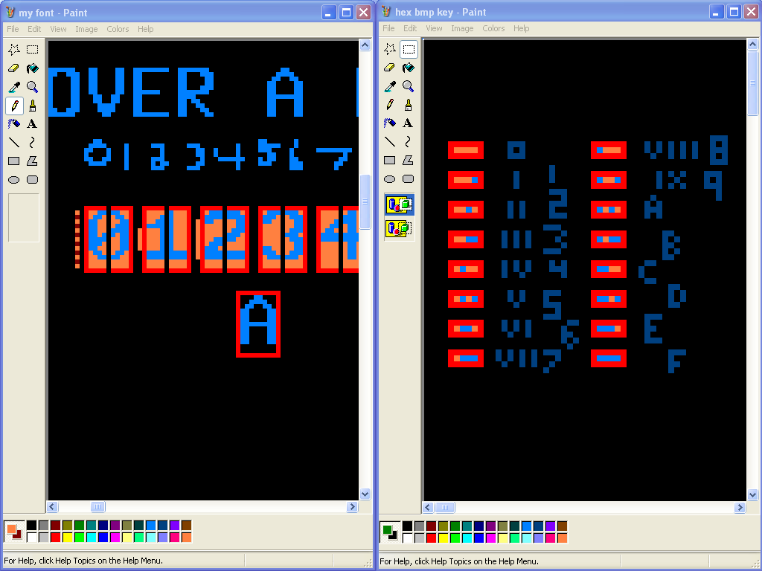
Reference Diagram

Slide 18
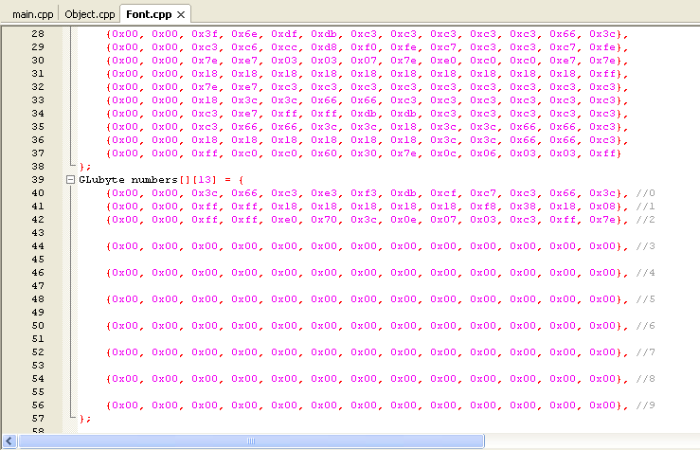
Step 3 – Program It

